Slide 1

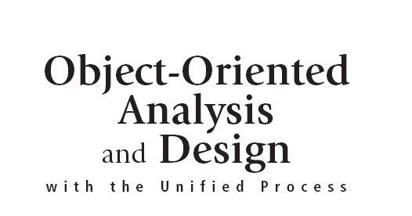


Slide 2
Objectives
Describe the activities of the requirements discipline
Describe the difference between functional and nonfunctional system requirements
Describe the kind of information that is required to develop system requirements
Explain the many reasons for creating information system models
Object-Oriented Analysis and Design with the Unified Process

Slide 3
Objectives (continued)
Determine system requirements through review of documentation, interviews, observation, prototypes, questionnaires, vendor research, and joint application design sessions
Discuss the need for validation of system requirements to ensure accuracy and completeness and the use of a structured walkthrough
Discuss the need for validation of system requirements to ensure accuracy and completeness and the use of a structured walkthrough
Object-Oriented Analysis and Design with the Unified Process

Slide 4
Overview
Requirements discipline prominent in elaboration phase
Requirements discipline focuses on models
  Fact-finding
  Investigation techniques
Analysts need to be familiar with business concern
  Bring a fresh perspective to a problem
  Build credibility with users within the organization
Object-Oriented Analysis and Design with the Unified Process

Slide 5
The Requirements Discipline in More Detail
Focus shifts from defining to realizing objectives
Activities spread over many iterations of UP
Requirements activities linked to other disciplines:
  design, implementation, and testing
Output of iteration within elaboration phase is working software
Object-Oriented Analysis and Design with the Unified Process

Slide 6
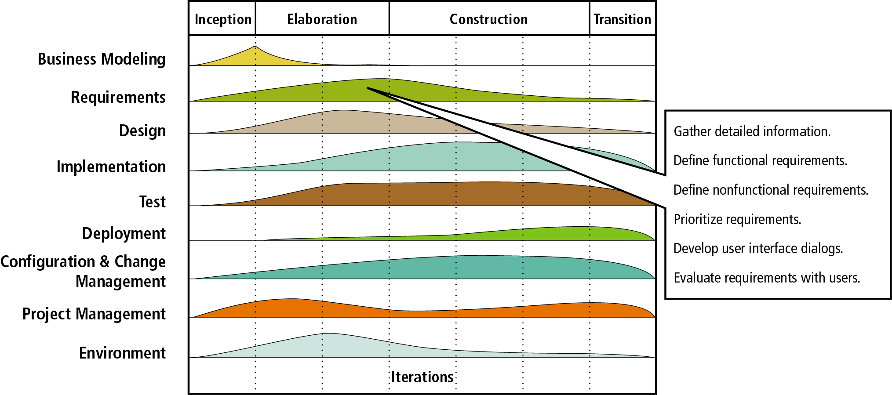
Figure 4-1
Activities of the Requirements Discipline
Object-Oriented Analysis and Design with the Unified Process

Slide 7
Gather Detailed Information
Analysts need to dialog with users of new system
Analysts should dialog with users of similar systems
Analysts must read documentation on existing system
Develop expertise in business area system will support
Other technical information should be collected
  Computer usage, work locations, system interfaces, and software packages
Object-Oriented Analysis and Design with the Unified Process

Slide 8
Define Requirements
Models record/communicate functional requirements
Modeling continues while information is gathered
Process of refining is source of learning for analyst
Specific models built depend on developing system
The UP provides a set of possible model types
  Some model types satisfy object-oriented requirements
  Analysts select models suited to project and skill-set
Object-Oriented Analysis and Design with the Unified Process

Slide 9
Prioritize Requirements
Users tend to request sizeable number of functions
Scarcity of resources limit function implementation
Scope creep: tendency of function list to grow
Scope creep adversely impacts project
  Leads to cost overruns
  May also cause implementation delays
Prioritization of functions is remedy to scope creep
Object-Oriented Analysis and Design with the Unified Process

Slide 10
Develop User Interface Dialogs
Interface as a sensory bridge to physical machine
Users familiar with functionality of interface
User feedback on new interface is reliable
Interface dialogs
  Model elicits and validate interface requirements
  May be paper storyboards or prototype
Object-Oriented Analysis and Design with the Unified Process

Slide 11
Evaluate Requirements with Users
Models built and validated as per user requirements
Process is iterative
Alternative models developed and continually revised
Object-Oriented Analysis and Design with the Unified Process

Slide 12
System Requirements
System requirements consist of capabilities and constraints
System requirements fall into two categories
  Functional
    Directly related to use cases
    Documented in graphical and textual models
  Nonfunctional
    Performance, usability, reliability, and security
    Documented in narrative descriptions to models
Object-Oriented Analysis and Design with the Unified Process

Slide 13
Models and Modeling
Models are great communicators
  Leverage visual cues to convey information
  Reduce complexity of components to essentials
Models are configured within a hierarchy
Model granularity can be adjusted by analyst
UML activity diagram is one type of model
  Focuses on both user and system activities
Object-Oriented Analysis and Design with the Unified Process

Slide 14
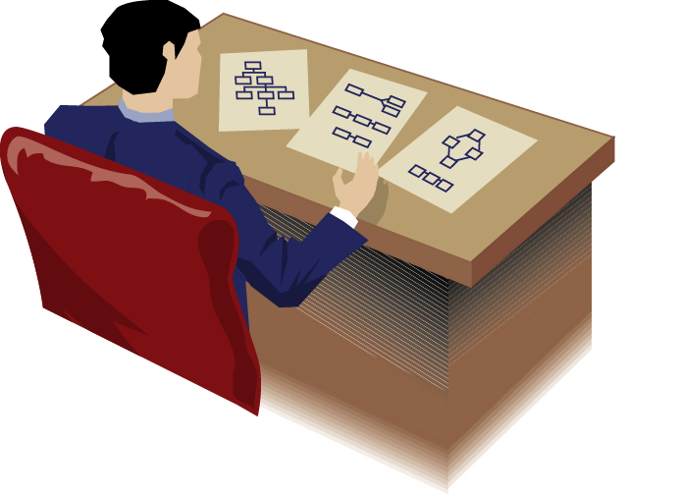
Figure 4-2
An Analyst Needs a Collection of Models to Understand System Requirements
Object-Oriented Analysis and Design with the Unified Process

Slide 15
The Purpose of Models
Modeling as a dynamic process
  Draws together various team members and users
  Simulates electronic execution of tasks
  Spurs refinement and expansion of requirements
  Promotes informal training
Model development tools
  Simple implements such as pencil and paper
  Sophisticated tools such as CASE
Object-Oriented Analysis and Design with the Unified Process

Slide 16
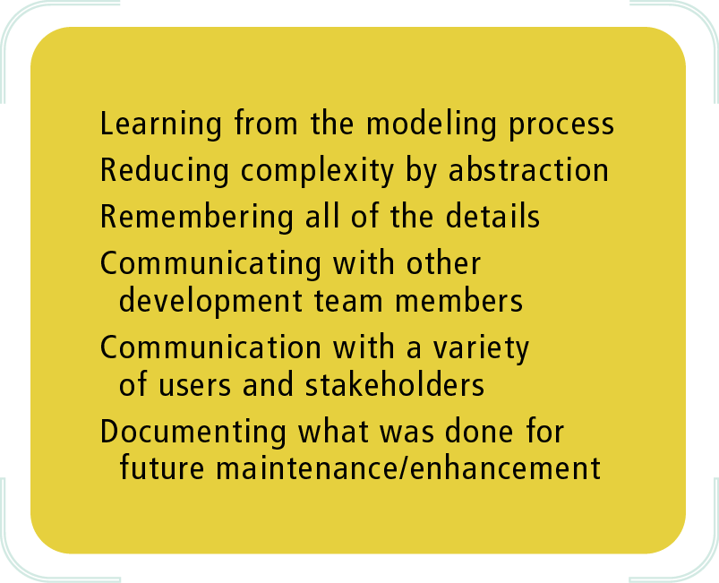
Figure 4-3
Reasons for Modeling
Object-Oriented Analysis and Design with the Unified Process

Slide 17
Types of Models
There are no universal models
Models chosen based on nature of information
Selection process begins with categorization
  Mathematical models
  Descriptive models
  Graphical models
Object-Oriented Analysis and Design with the Unified Process

Slide 18
Mathematical Models
Series of formulas describing technical aspects
Scientific, engineering, and business applications depend on mathematical models
Specific examples
  Equations representing network throughput
  Function expressing query response time
Object-Oriented Analysis and Design with the Unified Process

Slide 19
Descriptive Models
Narrative memos, reports, or lists
Provide high-level views
Information not reflected in mathematical models
Usually incorporated into graphical schemes
Object-Oriented Analysis and Design with the Unified Process

Slide 20
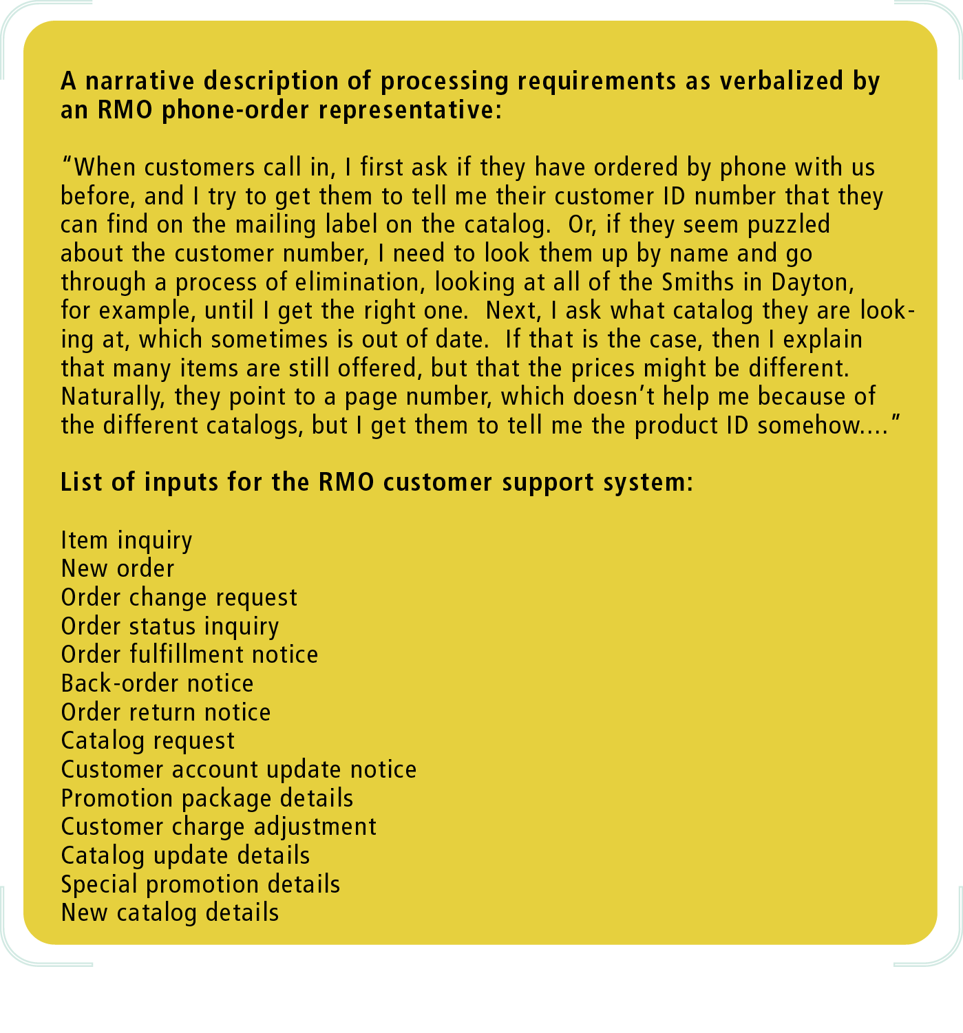
Figure 4-4a
Some Descriptive Models
Object-Oriented Analysis and Design with the Unified Process

Slide 21
Figure 4-4b
Some Descriptive Models
Object-Oriented Analysis and Design with the Unified Process

Slide 22
Graphical Models
Graphical models provide instant information
Supplement abstract language of data processing
Unified Modeling Language (UML)
  Provides standards for object-oriented models
Object-Oriented Analysis and Design with the Unified Process

Slide 23
Overview of Models Used in Requirements and Design
Logical models specify processes
Physical models are based on logical models
  Implement some component of the system
  Included within the design discipline
UML diagrams are used in system development
Additional models also used
Object-Oriented Analysis and Design with the Unified Process

Slide 24
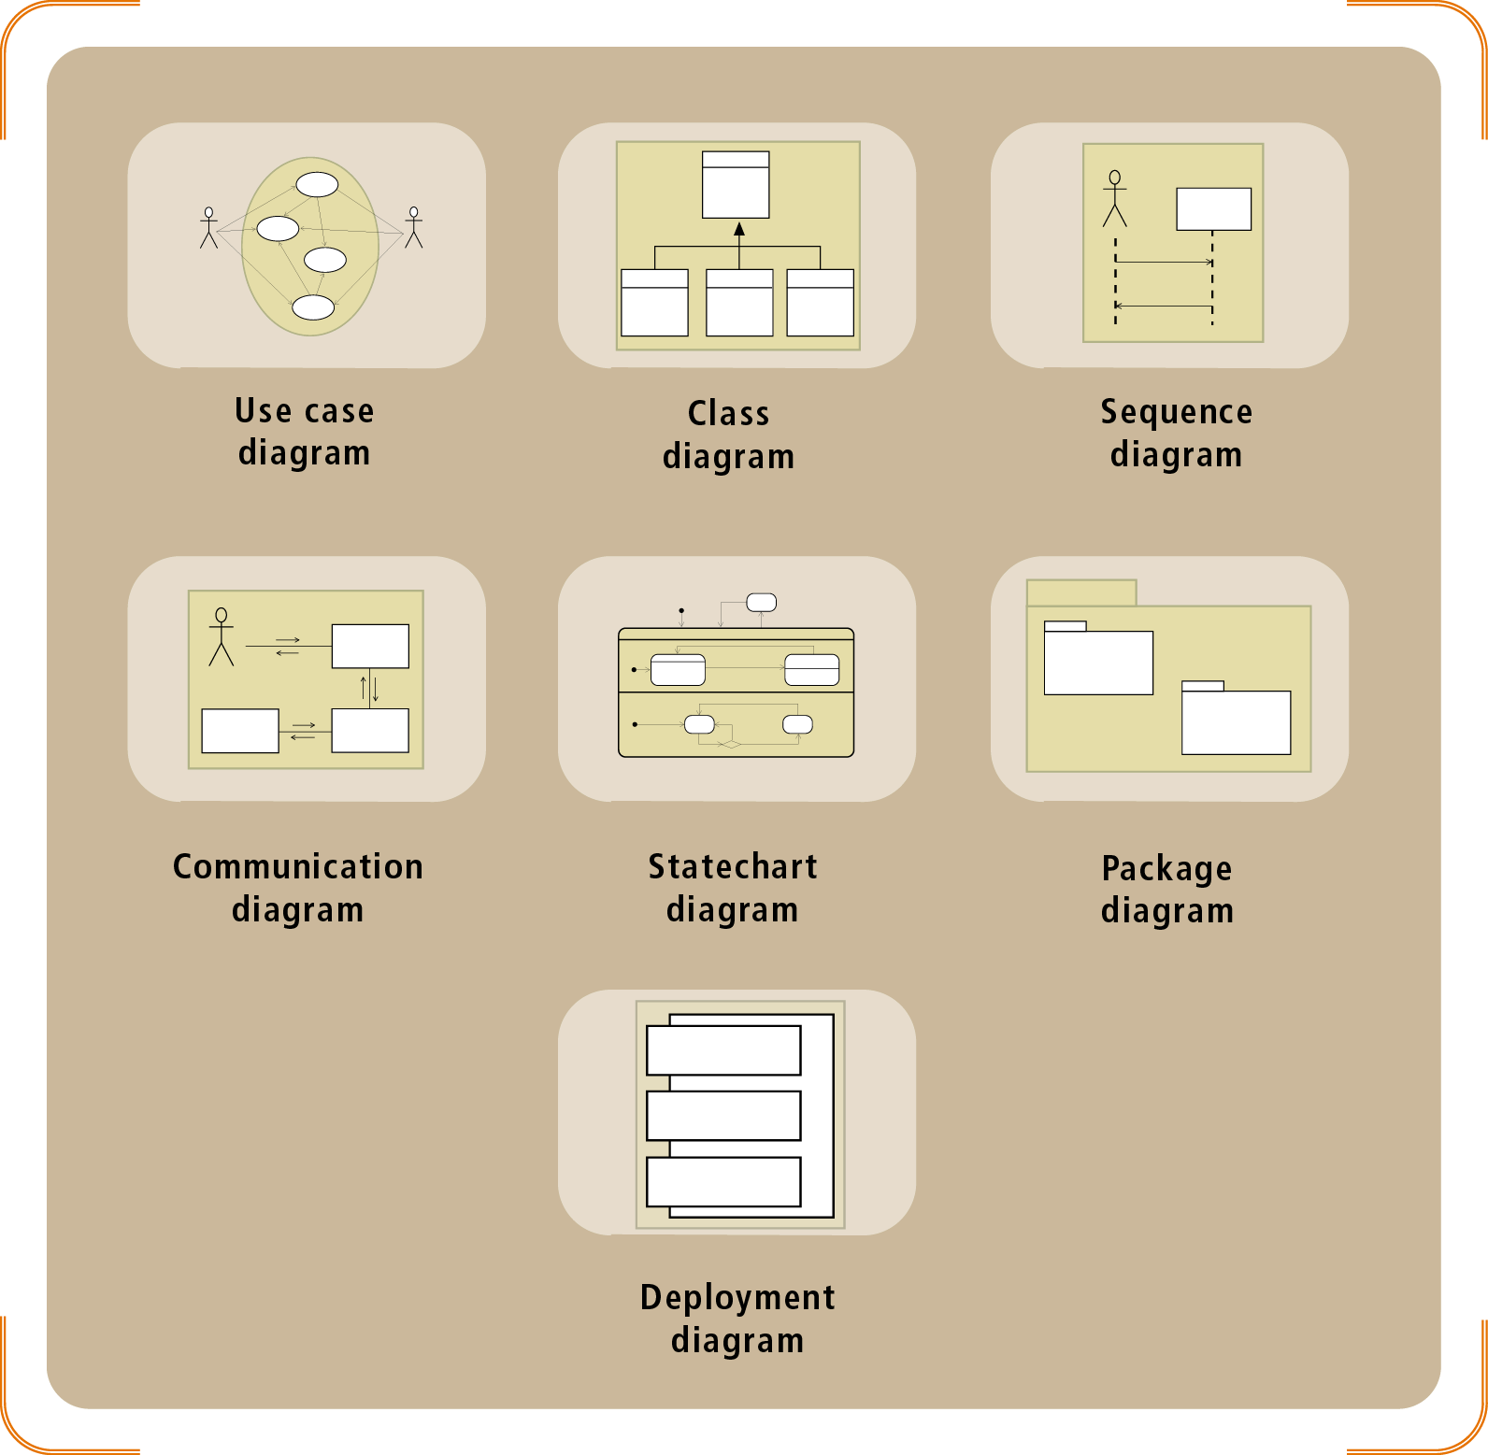
Figure 4-5
UML Diagrams used for Modeling
Object-Oriented Analysis and Design with the Unified Process

Slide 25
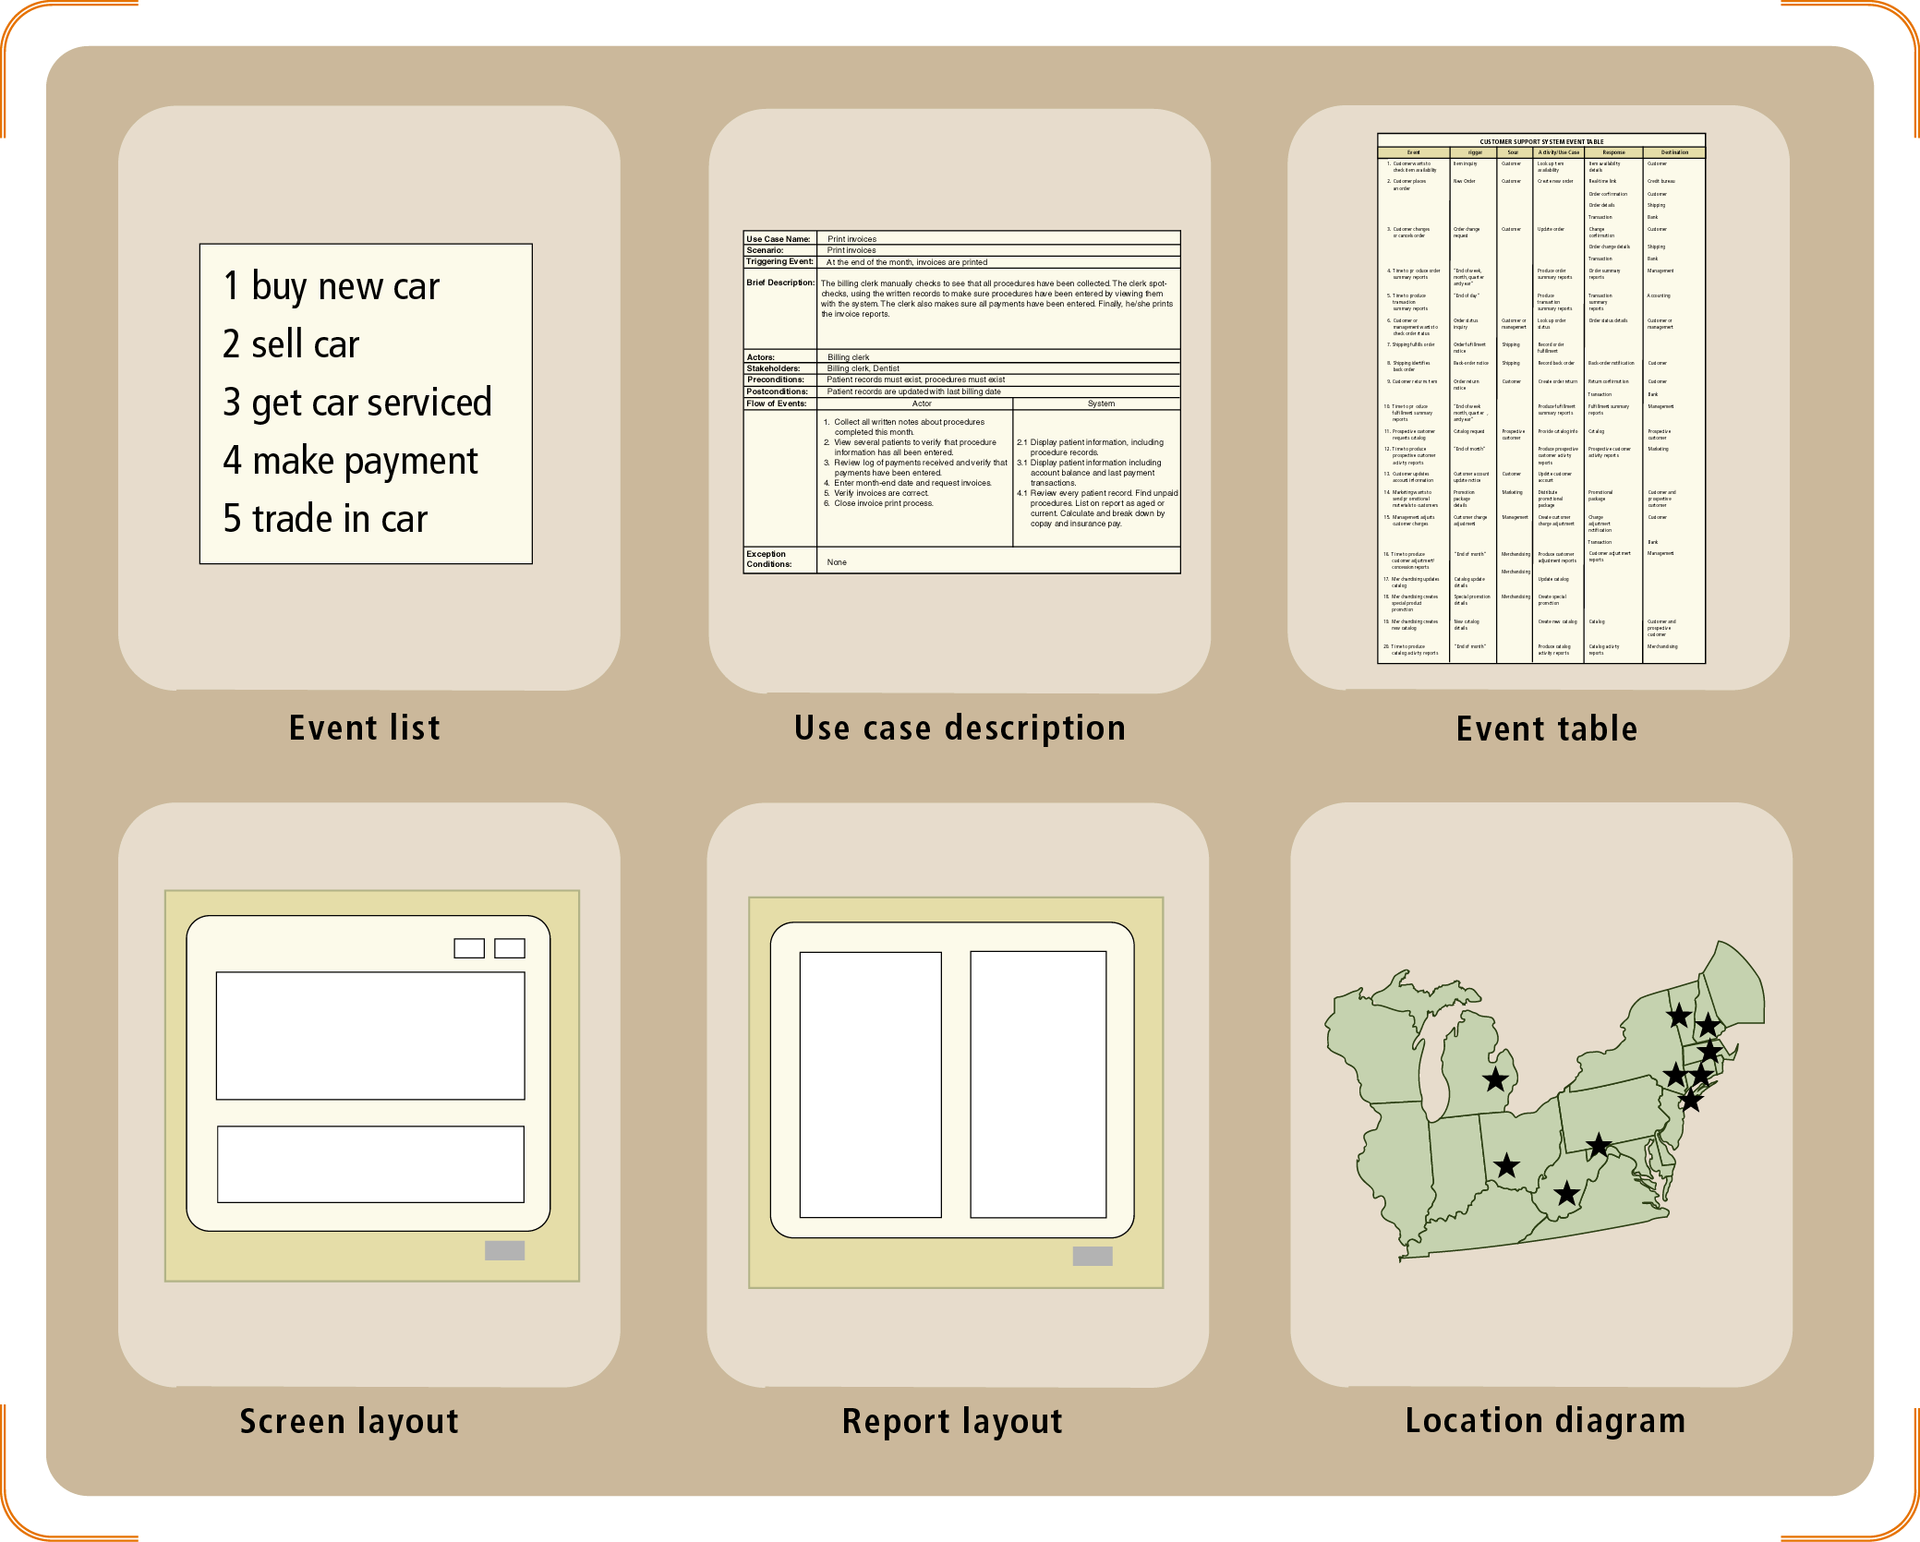
Figure 4-6
Additional Models used for Requirements and Design Disciplines
Object-Oriented Analysis and Design with the Unified Process

Slide 26
Techniques for Information Gathering
Questioning, observing, researching, modeling
Good questions initiate process
Questions center around three themes
  What are business processes?
  How is the business process performed?
  What information is required?
Object-Oriented Analysis and Design with the Unified Process

Slide 27
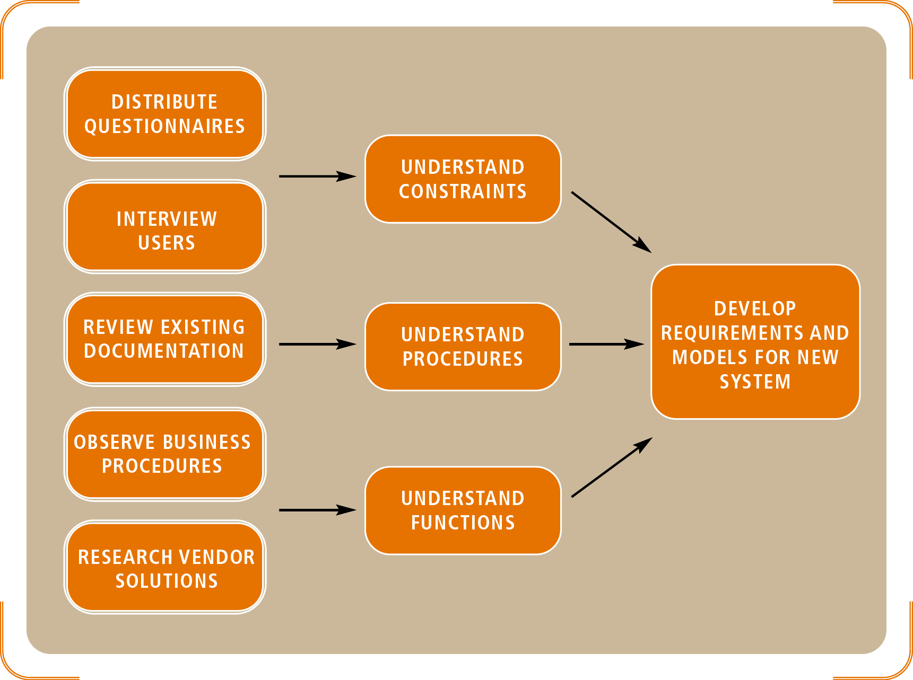
Figure 4-7
The Relationship between Information Gathering and Model Building
Object-Oriented Analysis and Design with the Unified Process

Slide 28
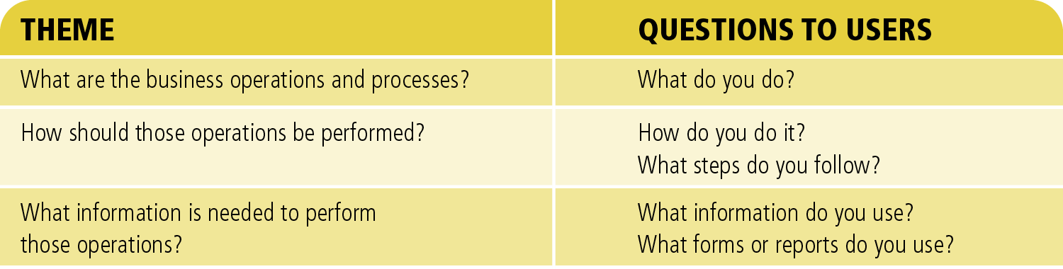
Figure 4-8
Sample Themes for Defining Requirements
Object-Oriented Analysis and Design with the Unified Process

Slide 29
Techniques for Information Gathering (continued)
Review reports, forms, procedure, descriptions
Several sources:
  Internal business documents and procedure descriptions
  Other companies and professional organizations
  Industry journals and magazines reporting “best practices”
Analysts should validate discovered information with system users
Object-Oriented Analysis and Design with the Unified Process

Slide 30
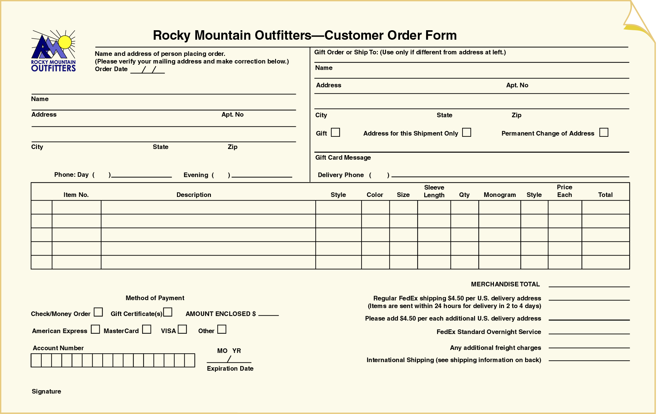
Figure 4-9
A Sample Order Form for Rocky Mountain Outfitters
Object-Oriented Analysis and Design with the Unified Process

Slide 31
Techniques for Information Gathering (continued)
Conduct interviews and discussions with the users
Break up interview into three phases:
  Preparation
  Enactment
  Follow-up
Analyst should become familiar with interview protocols
Object-Oriented Analysis and Design with the Unified Process

Slide 32
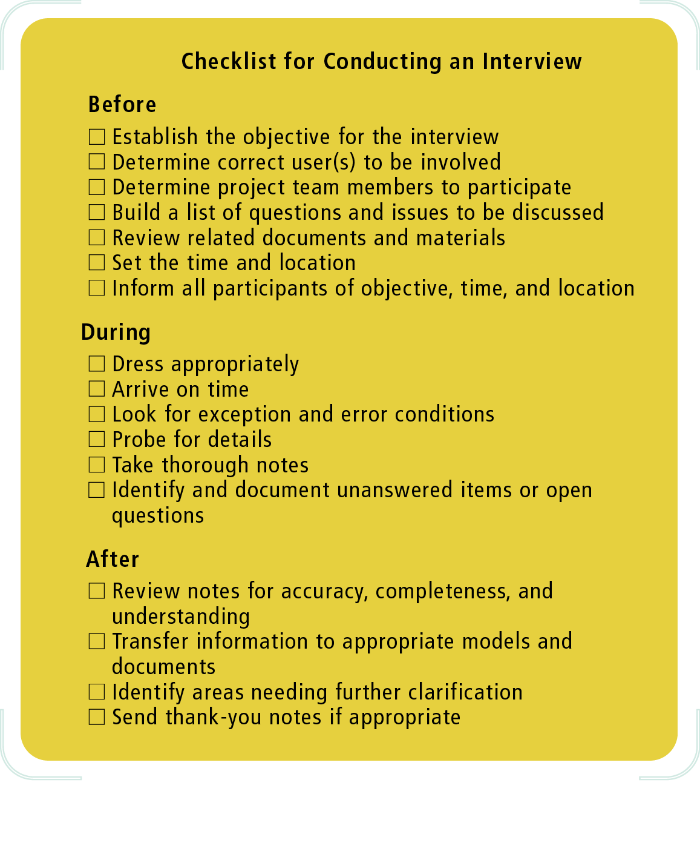
Figure 4-10
A Sample Checklist to Prepare for User Interviews
Object-Oriented Analysis and Design with the Unified Process

Slide 33
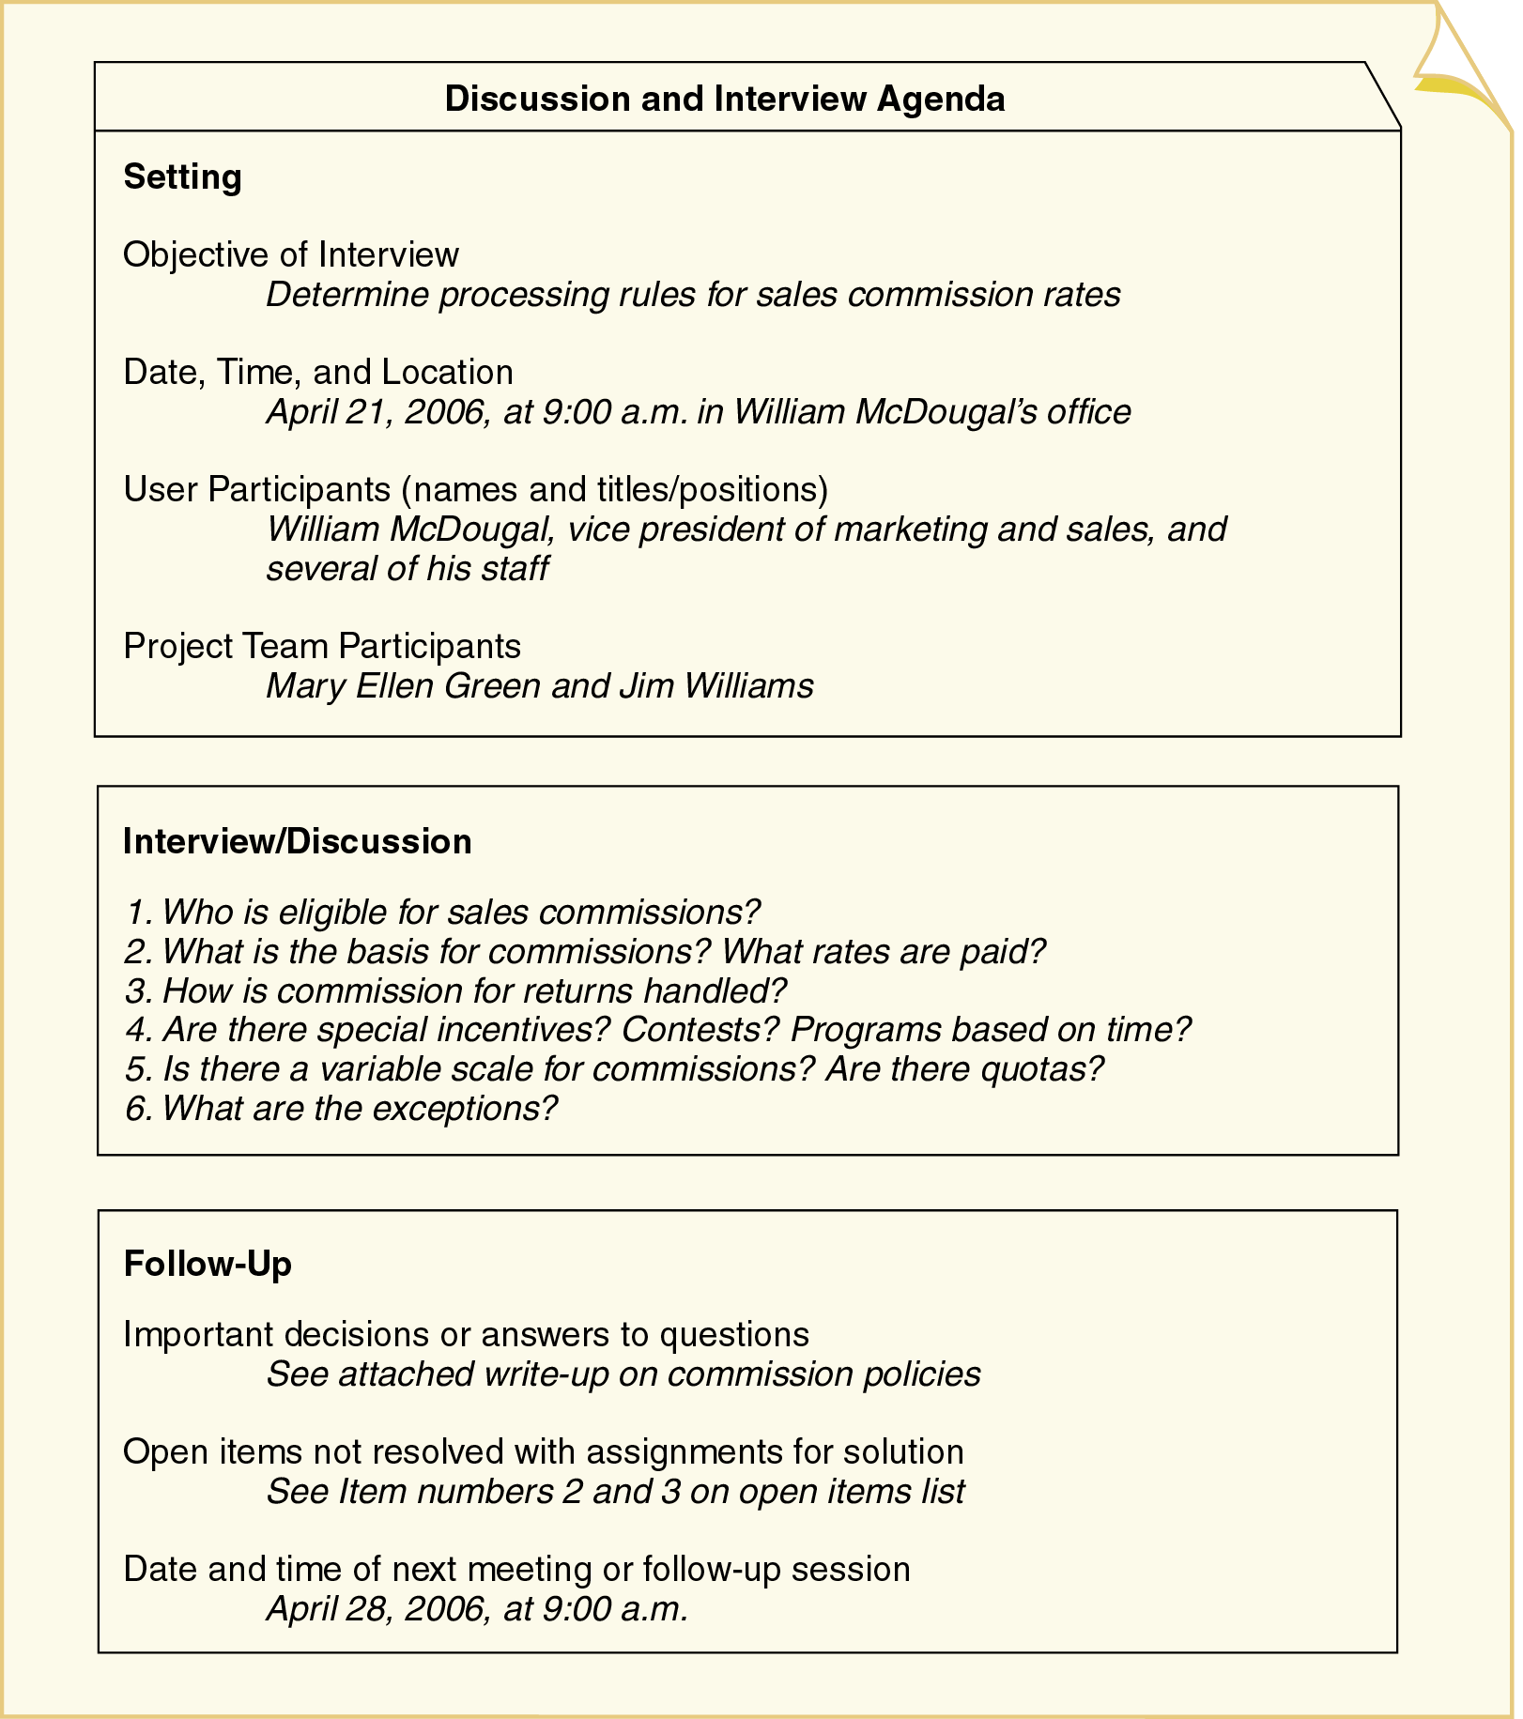
Figure 4-11
Sample Interview Session Agenda
Object-Oriented Analysis and Design with the Unified Process

Slide 34
Techniques for Information Gathering (continued)
Modestly observe business processes
Diagram all information gathered
Sample diagram: representation of workflow
  Identify agents to create the appropriate swim lanes
  Represent steps of workflow with appropriate ovals
  Connect activity ovals with arrows to show direction
  Use decision symbol to represent either/or situation
  Use synchronization bars for parallel paths
Object-Oriented Analysis and Design with the Unified Process

Slide 35
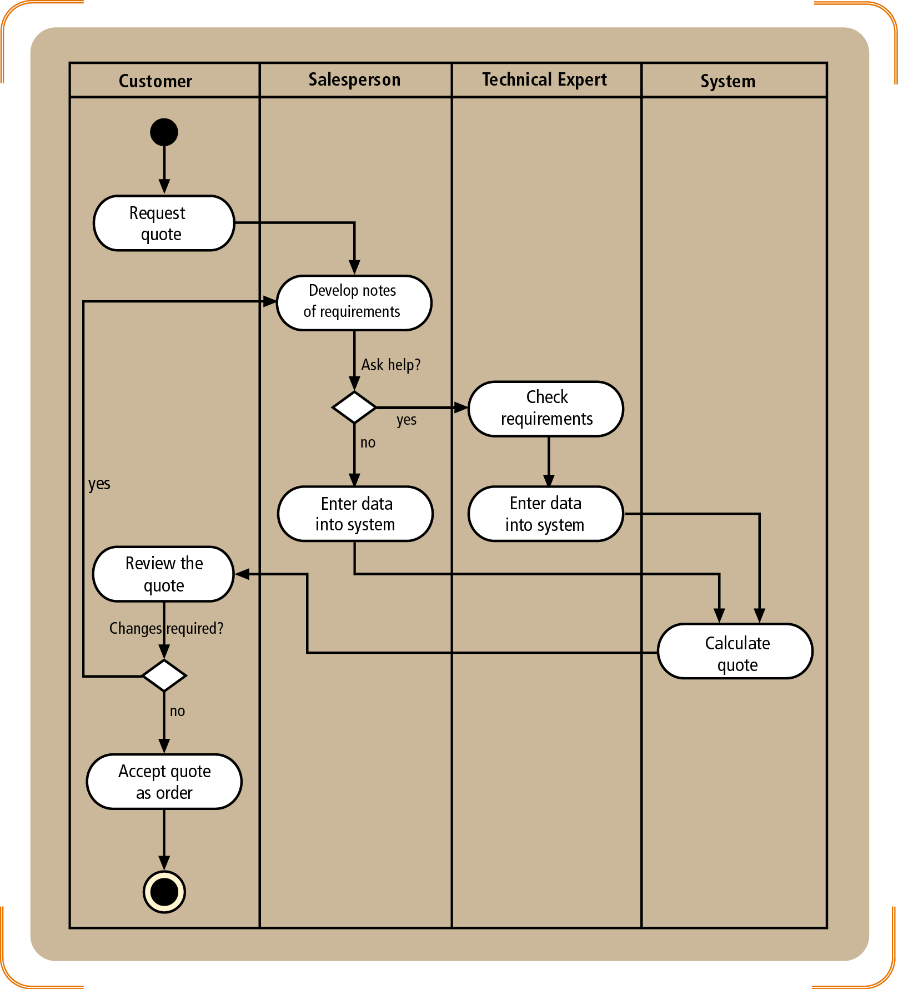
Figure 4-14
A Simple Activity Diagram to Demonstrate a Workflow
Object-Oriented Analysis and Design with the Unified Process

Slide 36
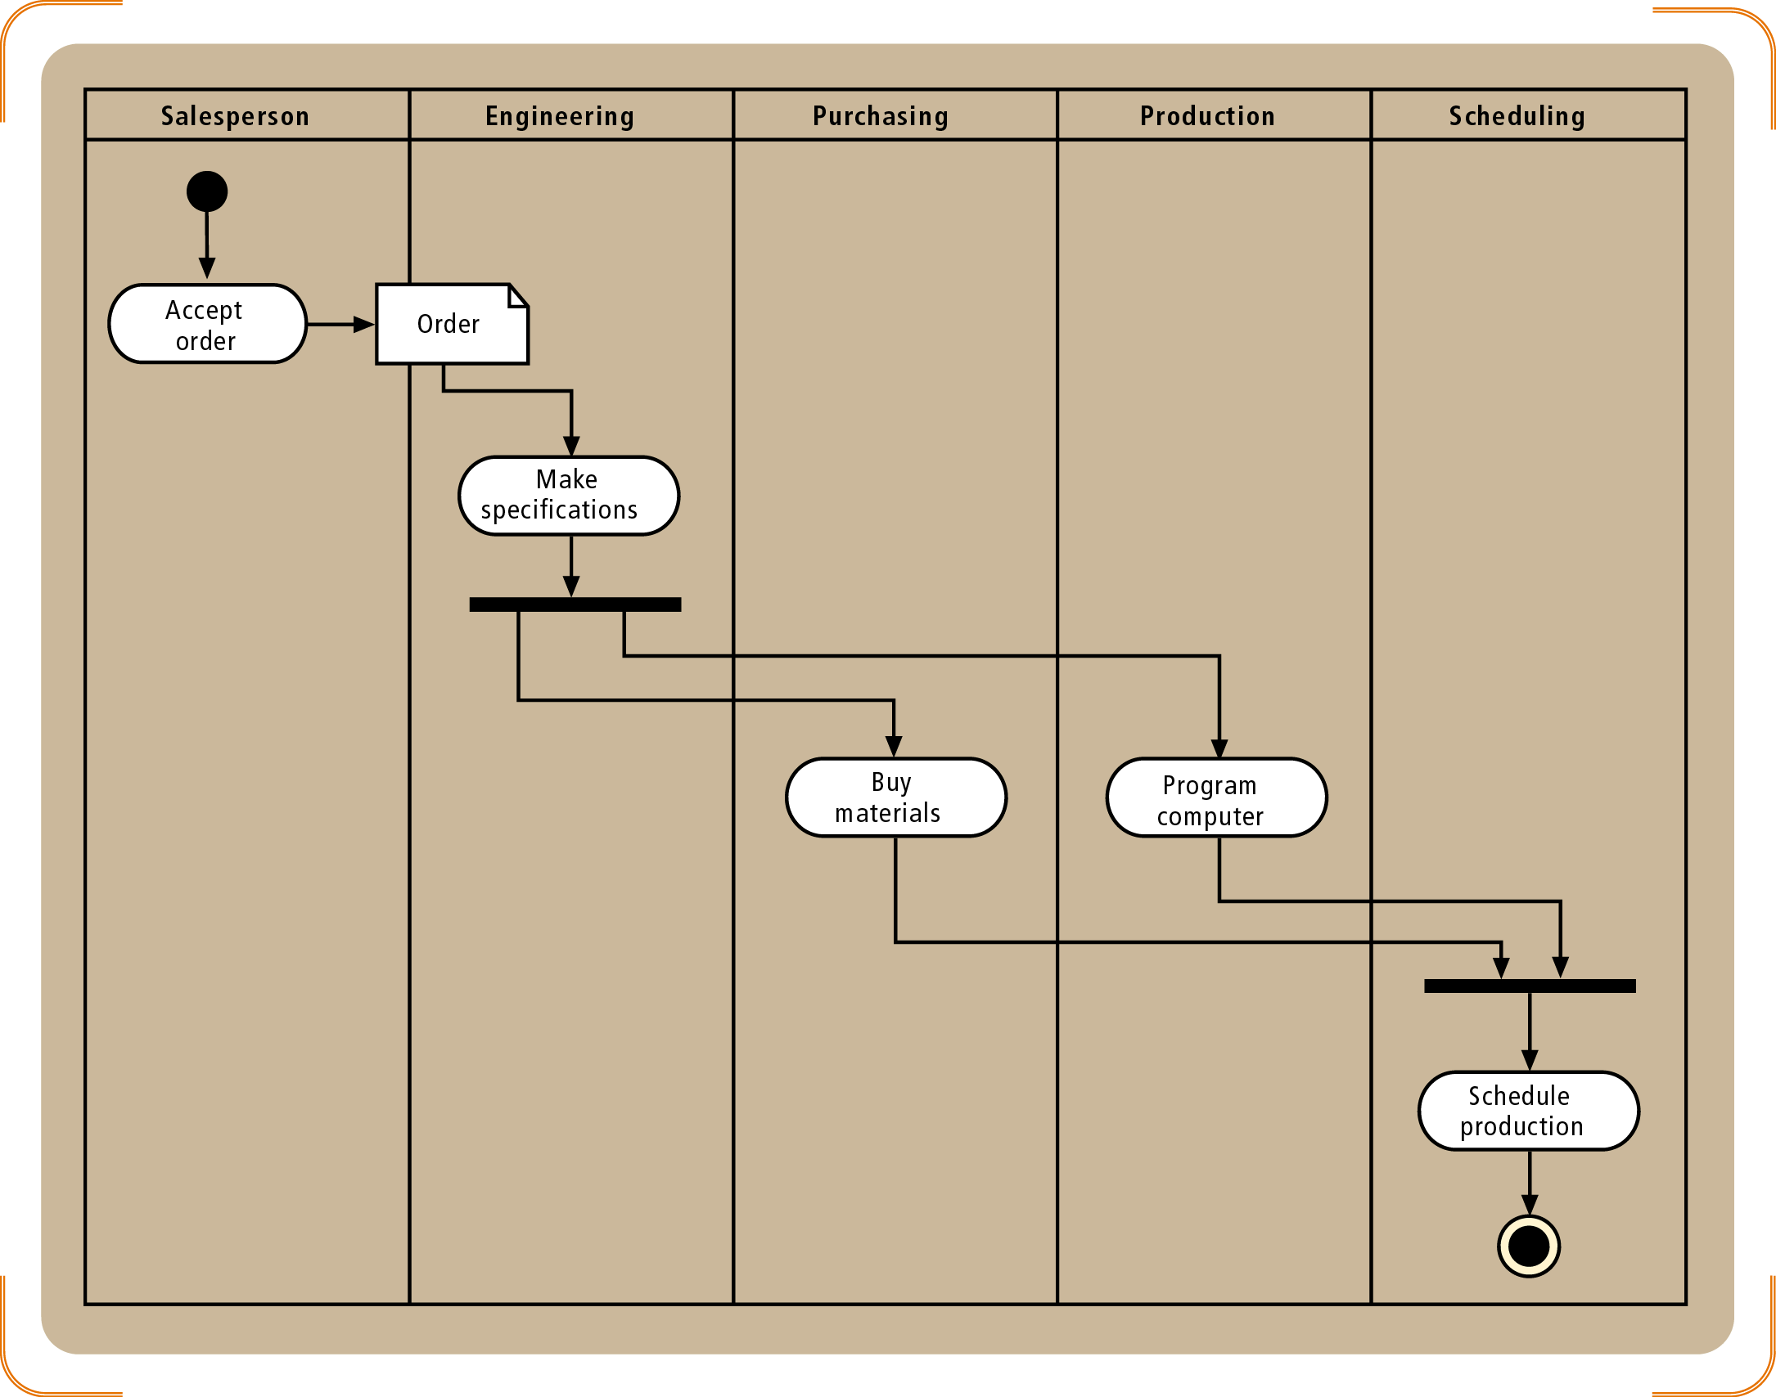
Figure 4-15
An Activity Diagram Showing Concurrent Paths
Object-Oriented Analysis and Design with the Unified Process

Slide 37
Techniques for Information Gathering (continued)
Building effective prototypes
  Operative
  Focused
  Quickly composed (especially using CASE tools)
Distribute and Collect Questionnaires
Conduct Joint Application Design Sessions (JAD)
  Includes JAD Session Leader, users, technical staff, project team members
Object-Oriented Analysis and Design with the Unified Process

Slide 38
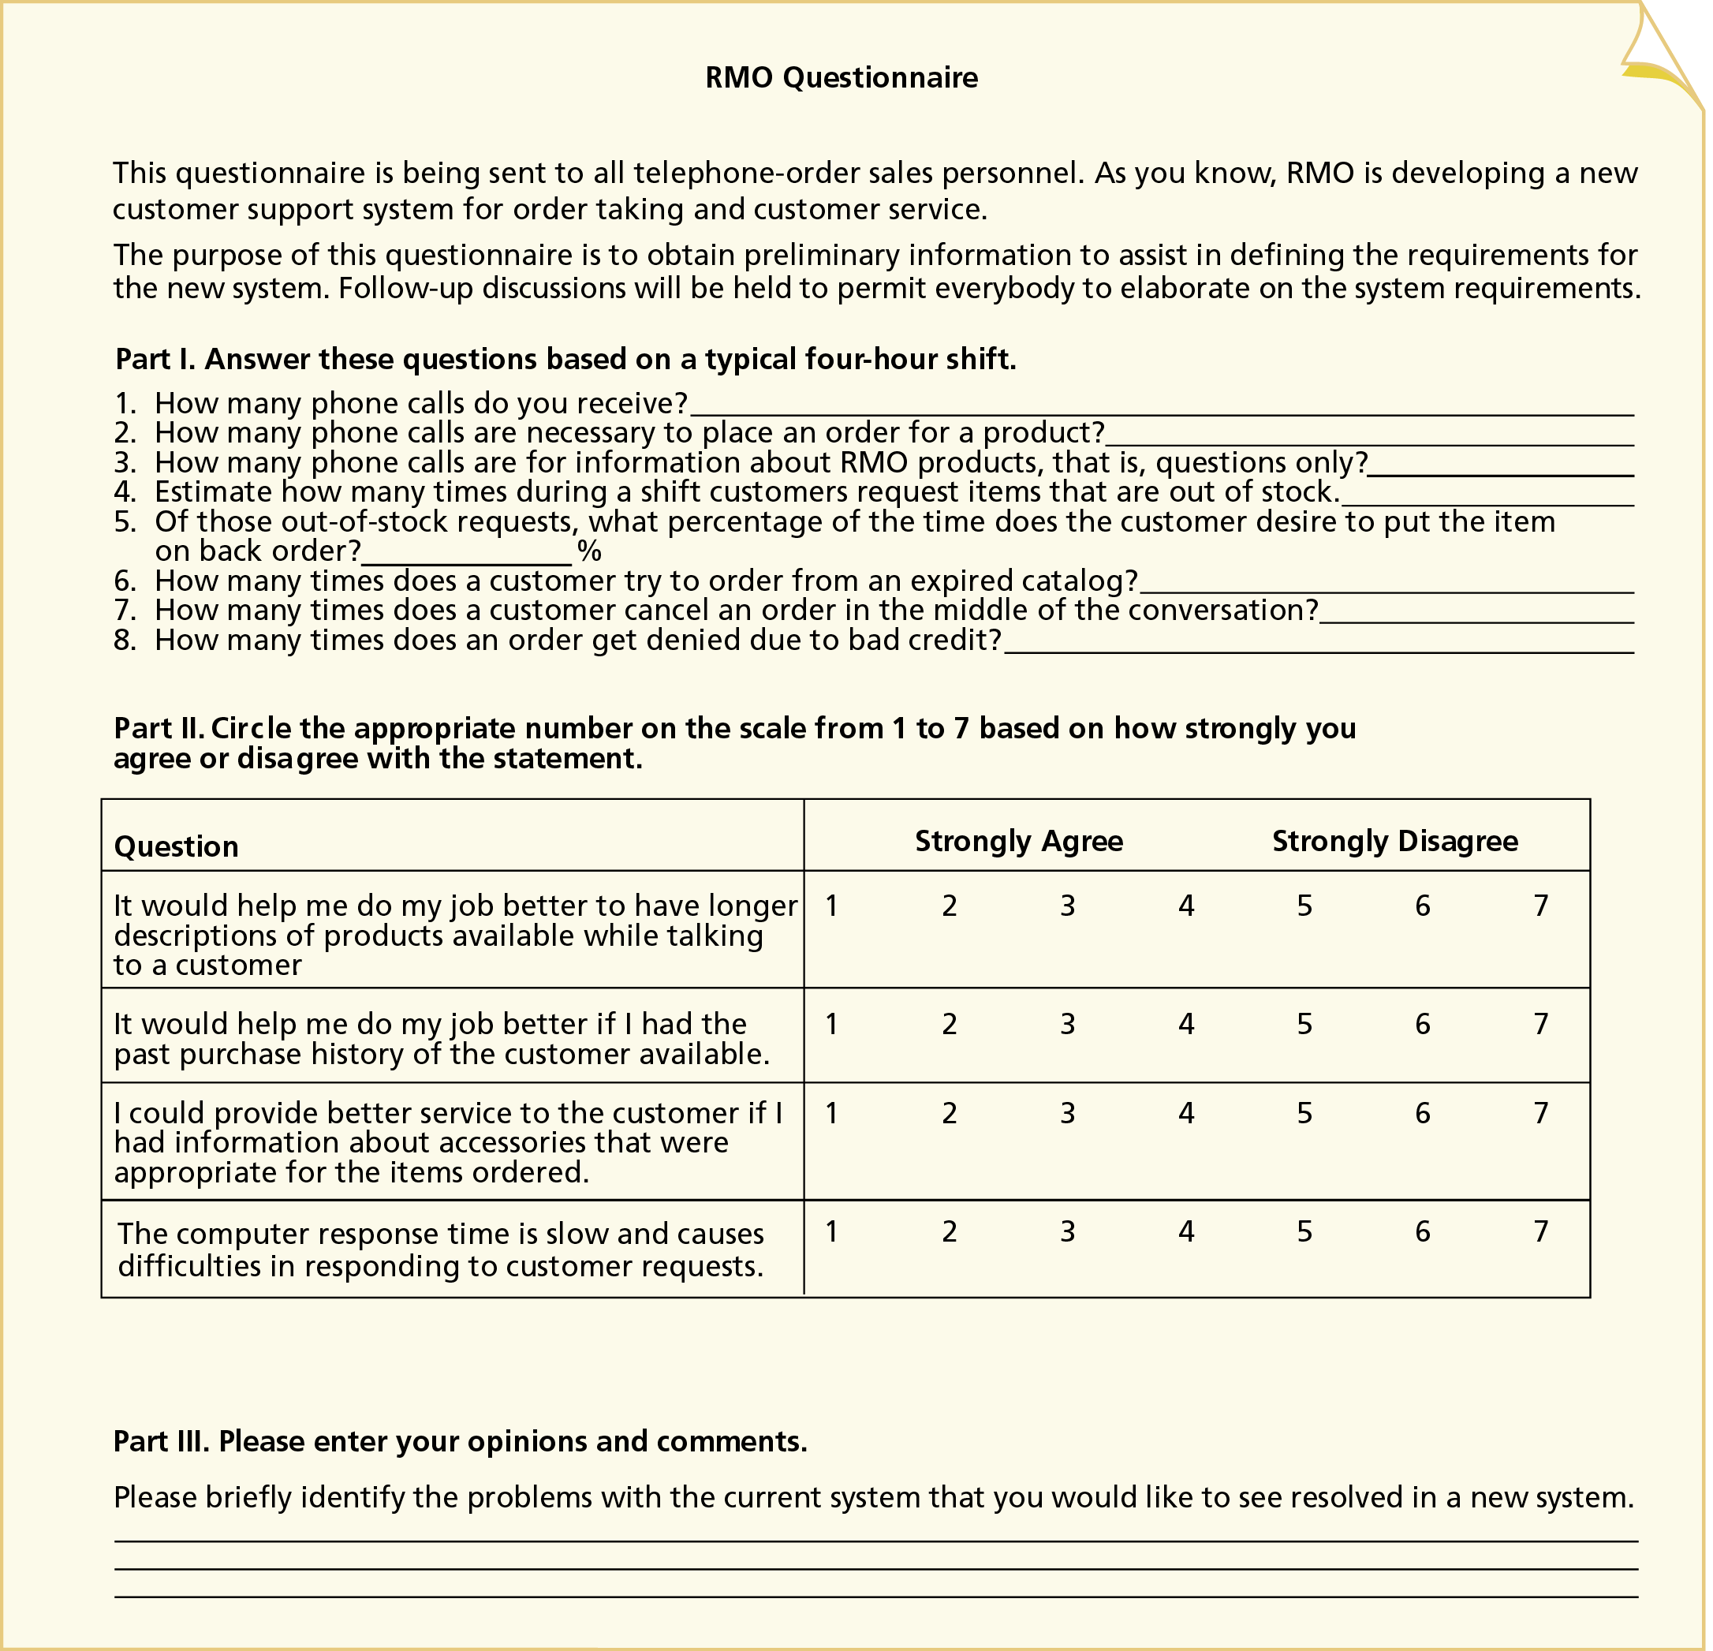
Figure 4-16
A Sample Questionnaire
Object-Oriented Analysis and Design with the Unified Process

Slide 39
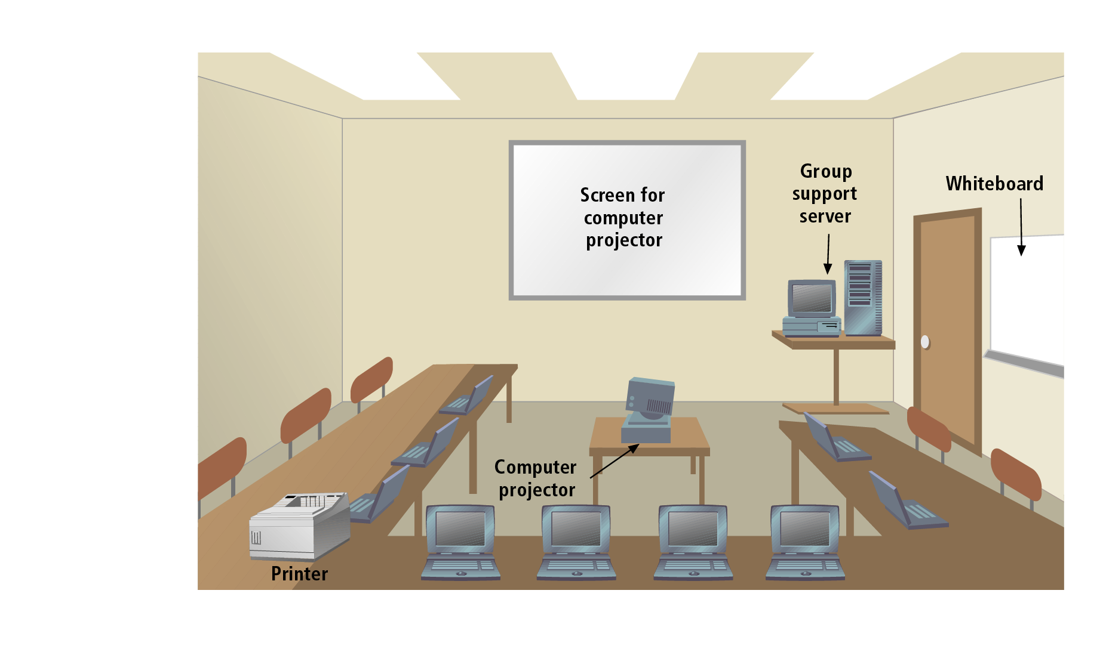
Figure 4-17
JAD Facility
Object-Oriented Analysis and Design with the Unified Process

Slide 40
Techniques for Information Gathering (continued)
Research Vendor Solutions as a two-step process
Develop list of providers from various sources
  Directories
  Recommendations
  Journals, magazines, and trade shoes
Research the details of each solution
Object-Oriented Analysis and Design with the Unified Process

Slide 41
Validating the Requirements
Two basic approaches to validating requirements
  Predictive development
    Requirements assumed stable and feasible
    Requirements specified and validated beforehand
  Adaptive development (embodied in UP)
    Requirements are assumed difficult to document
    Requirements subject to change
    System prototypes used in validation process
Object-Oriented Analysis and Design with the Unified Process

Slide 42
Validating the Requirements (continued)
Alternatives to developing costly prototypes
  Structured walkthrough and mathematical models
Structured walkthrough
  Reviews findings
  Reviews models based on findings
  Objective: find errors and problems
  Purpose: ensure that model is correct
Object-Oriented Analysis and Design with the Unified Process

Slide 43
Validating the Requirements (continued)
Setting structured walkthrough parameters
  Determine documents to be reviewed
  Determine frequency or schedule
  Select analyst to be reviewed and reviewers
Conducting structured walkthrough
  Preparation
  Execution
  Follow-up
Object-Oriented Analysis and Design with the Unified Process

Slide 44
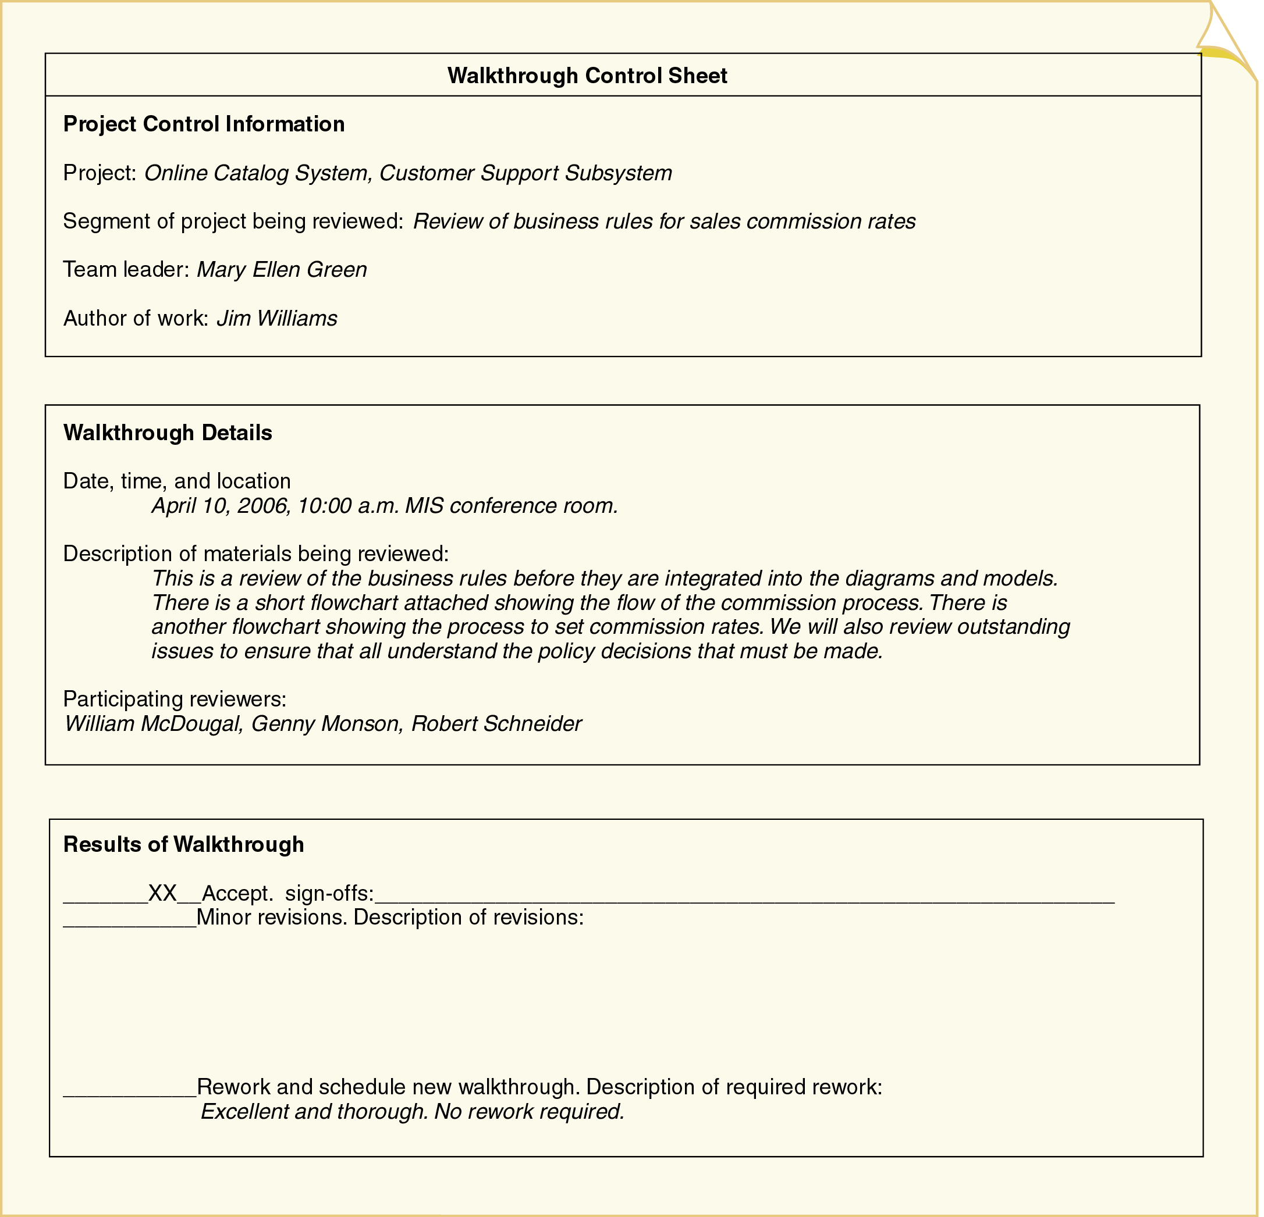
Figure 4-18
A Structured Walkthrough Evaluation Form
Object-Oriented Analysis and Design with the Unified Process

Slide 45
Summary
System requirements: functional and nonfunctional
Discipline activities: information gathering, definition, prioritization, and evaluation of requirements, and the development of user interface dialogs.
Models: reduce complexity and promote learning
Model types: mathematical, descriptive, graphical
UML: standard modeling notation
Object-Oriented Analysis and Design with the Unified Process

Slide 46
Summary (continued)
Seven primary techniques for gathering information
One technique to ensure information correctness
Prototype: working model of a more complex entity
Joint application design (JAD): comprehensive information gathering technique
Validate by testing prototypes or completing structured walkthroughs
Object-Oriented Analysis and Design with the Unified Process

